Slide 1
Welcome! To The Migrant Education Program

Slide 2
Land Acknowledgement
We would like to acknowledge that we’re coming to you from the traditional lands of the first people of our valley, the 14 Confederated Tribes and Bands of the Yakama Nation, and we honor with gratitude the land itself and the Yakama Tribe.
Notes:
If there is another land that you would like to acknowledge, please feel free to do so in the chat.

Slide 3
New FPD
Migrant Education Program (MEP) Orientation

Slide 4
Migrant Education MythBusters – (Common Misconceptions)
https://animoto.com/play/ReMybY7rC7b8Rcv5TLBXmA

Slide 5
We are part of your MEP Team:
Cynthia Juarez- Executive Director
Cindy Cholico-MEP Manager
Maggie Mendoza-Migrant P-3
Claudia Dominguez-Family Engagement/Student Leadership
Erica Peppers-Math & Science
Valeria Villa-OSY/Health
Angelica Hernandez-ELA
Rose George-Indigenous Education Coordinator
Victoria Ibarra-MEP Support Specialist
Oscar Godinez-Migrant Career Readiness Coordinator

Slide 6
You are the Champion MEP Students Need

Slide 7
Congratulations!
You are now an FPD of an LEA with a MEP that uses MSIS data overseen by MSDR. Your SOW is established by OSPI and includes COE’s with QAD’s for both in-school and OSY, grant management in EGM, working with a PAC, possibly the SAC, an annual CNA, and undergoing CPR.
Notes:
https://docs.google.com/document/d/1QsptD88Ywcd1RVtUjy3rv_g5GNinB2n6ipkbNHw998s/edit?usp=sharing

Slide 8
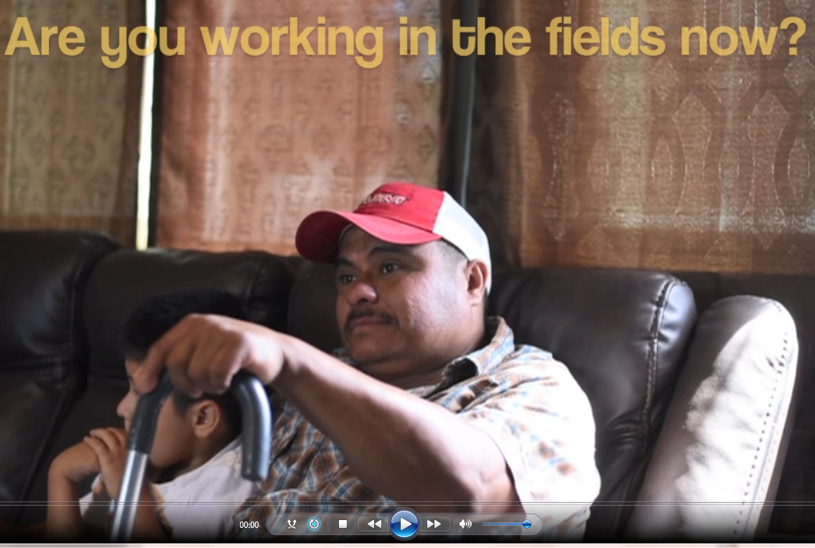
Acronyms
MEP
CNA
SDP
MSDR
MSIS
ESD
SOW
CPR
PAC
OSY
PFS
Home visiting video available in shared folder
Notes:
MEP: Migrant Education Program
FPD: Federal Project Director
SDP: State Delivery Plan
MSDRS: Migrant Student Data Recruitment & Support
MSIS: Migrant Student Information System
CPR: Consolidated Program Review
PAC: Parent Advisory Council
OSY: Out of School Youth
PFS: Priority for Service

Slide 9
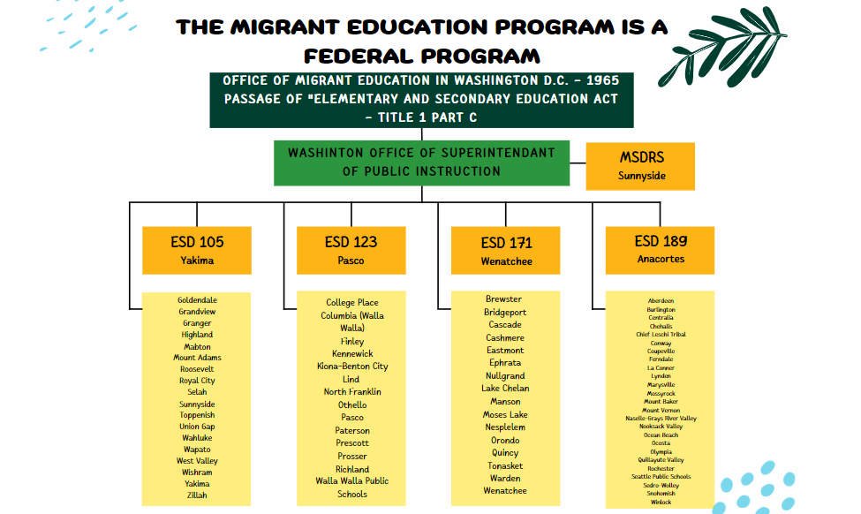
Migrant Education Program
Organizational Chart

Slide 10
ESD Migrant Education Offices
ESD 105
Cynthia Juarez
Executive Director of Early Learning & Migrant Education
ESD 123
Lupe Mota Migrant Education Program Administrator
ESD 171 (NCESD)
Cyndy Valdez
Migrant Education Director
ESD 189
Sarah Southard
Director of Early Learning and Migrant Education
Notes:
Cynthia

Slide 11
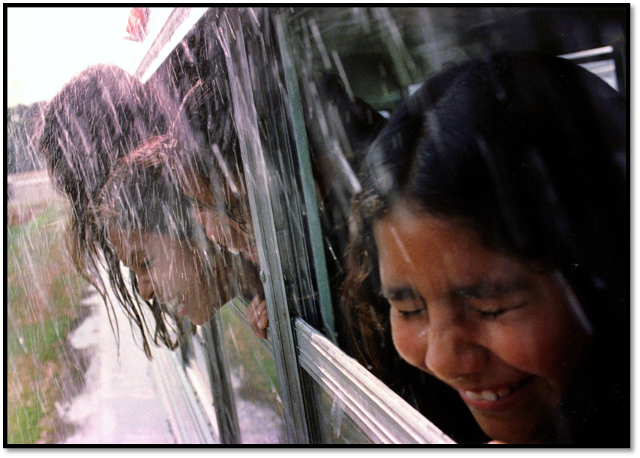
Migrant Education is a Federal Program
1965 Passage of “Elementary and Secondary Education Act”
Title 1, Part C Migrant Education Program to address the special needs of mobile farm worker children.
Notes:
Talk about ELL vs. Migrant

Slide 12
Program Purpose ESEA – Section 1301
1. High-quality educational programs and services
2. Not penalized by disparities among States (curriculum, graduation requirements, and challenging State academic standards).
3. Opportunities to meet challenging State academic standards all children are expected to meet.
4. Overcome factors that inhibit the ability to succeed.
5. Help migratory children benefit from State and local systemic reforms.
Notes:
Talk about ELL vs. Migrant

Slide 13
Migrant Education Program Priorities
Priority 1 – Academics: Close the opportunity gap for migratory students in English Language Arts (ELA) by providing supplemental services during the regular and summer program periods.
Priority 2 – Academics: Close the opportunity gap for migratory students in Mathematics by providing supplemental services during the regular and summer program periods.
Priority 3- Preschool Kindergarten Readiness: Close the school readiness opportunity gap for migratory children ages 3-5 by increasing the number of migratory children participating in program-funded services.
Priority 4- Graduation: Increase the number of migratory students receiving high quality, targeted support in order to increase graduation rates, dropout recovery, and services for Out of School Youth (OSY), including access to alternative learning environments.
Priority 5 – Eliminate Educational Barriers through Support Services: Increase access to Migrant Program funded support services; and increase the number of resolved Medically Diagnosed Alerts (MDAs).
Notes:
Talk about ELL vs. Migrant

Slide 14
Migrant Federal Program Director Roles:
Top 4 Responsibilities:
Conduct/facilitate a local needs assessment that identifies the needs of migrant students identified in the school district boundaries.
Develop and meet with a local parent advisory council to seek their input in addressing the identified needs. NOTE: Because the program funds would never be sufficient to address all the academic and support needs of migrant students, the FPD would look to coordinate resources with other federal, state, and local programs.
Complete the EGMS
Supervise the activities of staff employed in the program to ensure services and support activities, including records clerk and recruiting, are completed in accordance with federal and state requirements.
FPD Job Description Link and MEP OSPI Infographic

Slide 15
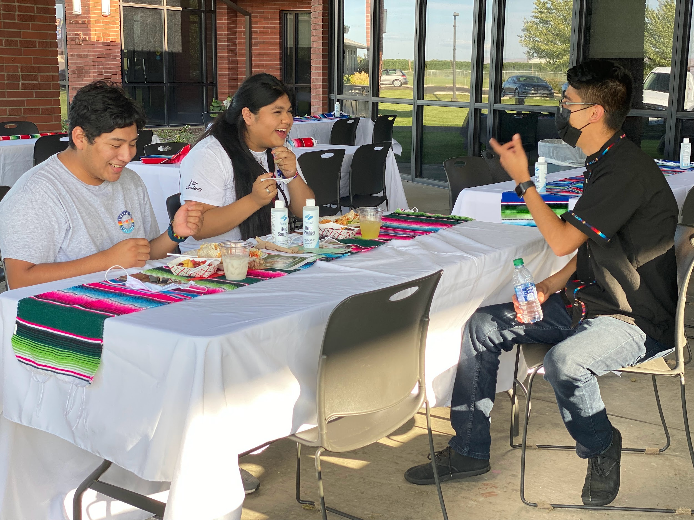
The Goal of MEP:
Is to ensure that all migrant students reach challenging academic standards and graduate with a high school diploma (or complete a GED) that prepares them for responsible citizenship, further learning, and productive employment.

Slide 16
Required Personnel and Job Descriptions:
Migrant Federal Program Director (FPD)
Records Clerk Total Students/800=FTE
Recruiter Total Students/600=FTE
If extra funds are available:
Migrant Graduation Specialists (MGS) 1FTE=50 students
Migrant Student Advocate (MSA) 1FTE=150 students
Migrant Academic Para or Teacher
Migrant Coordinators
Migrant Nurse
Migrant Mental Health Therapist

Slide 17
Who’s on the MEP Team?
Migrant Graduation Specialist & Student Advocate
Parent PAC (required)
Records Clerk(required)
Recruiter (required)
Nurse
Family Engagement / Liaison
ESD Migrant Office Coordinators
Notes:
Cindy:
Required Position:
*Parent PAC
*Records Clerk
*ID&R

Slide 18
Identification & Recruitment
AGE:
The child is 3-21 years old.
SCHOOL COMPLETION:
The child is eligible for a free public education (no HS diploma or GED).
MOVE within the past 36 months
The child and worker “moved” from one school district to another
IN ORDER TO OBTAIN:
One purpose of the worker’s move was to seek
or obtain “qualifying work.”
QUALIFYING WORK:
Temporary or seasonal employment in agricultural or fishing work.

Slide 20
Priority for Services
PFS Definition Doc
Section 1304 (d) Priority for Services- In providing services with funds received under this part, each recipient of such funds shall give priority to migrant children:
Who have made a qualifying move within the previous 1-year period and who are failing, to meet the challenging state academic standards; or have dropped out of school

Slide 21
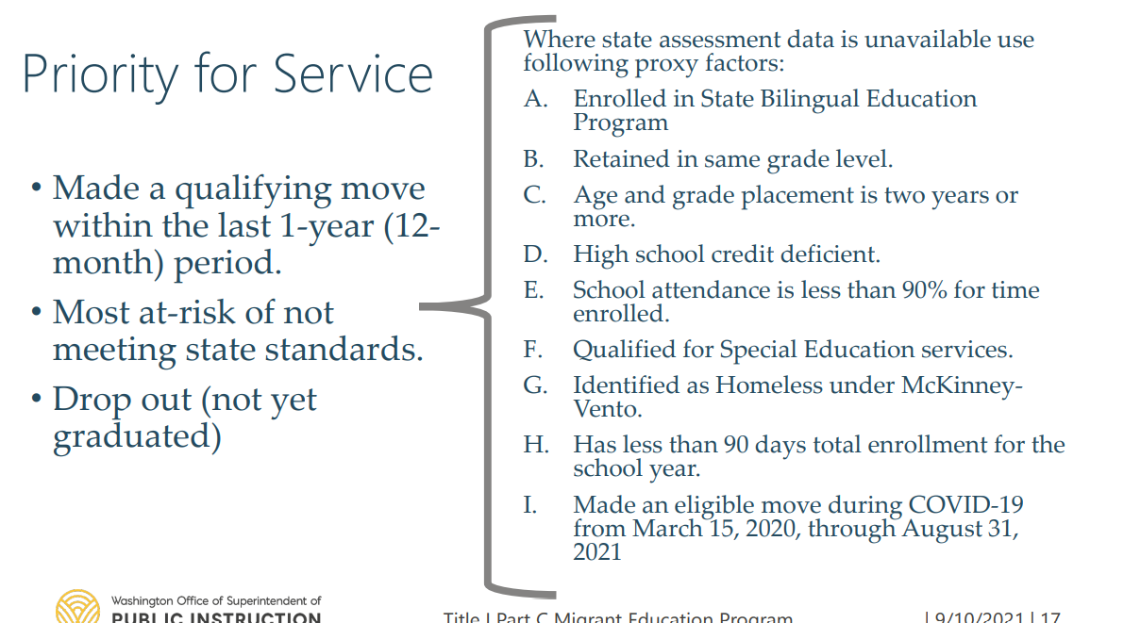
Priority for Services

Slide 22
Who We Service
Priority-for-Service
Performing
At-Level
Needs
Notes:
Reflect on Misconceptions and stereotypes
Migrant worker share a number of common lifestyle characteristics that prose significant challenges in their lives.
They experience relatively high levels of migration (mobility)
They often move from and to other countries (especially Mexico)
They are working poor (as a result of the low wages they are paid for their labor)
They usually have low levels of educational attainment
They often feel isolated from the larger community due to cultural adjustment problems and linguistic differences (between the U.S. and their country of origin)

Slide 23
Other Migrant Students
• Needs – students who may not have moved within the last 12 months (PFS) but are at-risk of not meeting state standards.
• Continuation of Service – students whose eligibility has ended but who may need continued Migrant Program support through the end of the term, for the school year or throughout their high school until they graduate. There must be no other resource available for students to access. High school is credit accrual services only.
• Out-of-School Youth – migratory students between the ages of 16-21 who are not enrolled in school and have not obtained a high school diploma or equivalent.
Notes:
Reflect on Misconceptions and stereotypes
Migrant worker share a number of common lifestyle characteristics that prose significant challenges in their lives.
They experience relatively high levels of migration (mobility)
They often move from and to other countries (especially Mexico)
They are working poor (as a result of the low wages they are paid for their labor)
They usually have low levels of educational attainment
They often feel isolated from the larger community due to cultural adjustment problems and linguistic differences (between the U.S. and their country of origin)

Slide 24
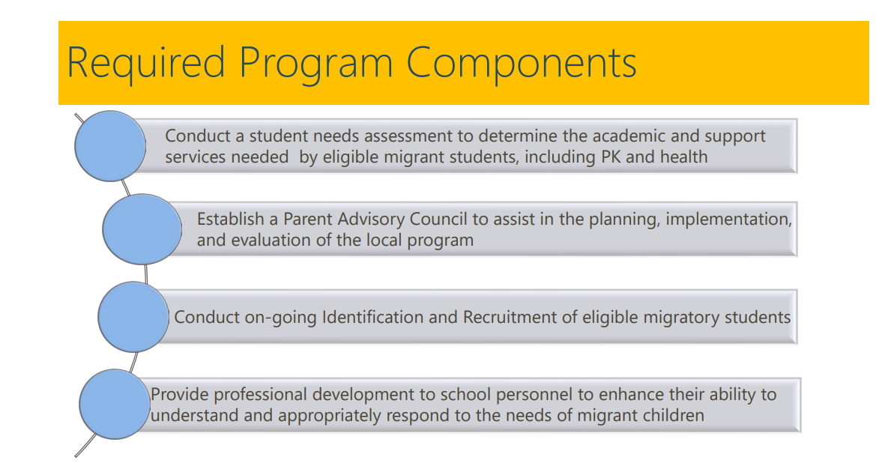

Slide 25
Application and Reports
*Grant can be updated throughout the year
Regular Year Grant Application – October 15
Regular Year End-of-Year Report – Due: July 15
Summer Program Report – Due: September 15
Fidelity of Strategy Implementation – Word document – Due: September 15
Parent Surveys focused on Family Literacy Engagement in math and ELA during the program period – Due: September 15
Staff Surveys – professional learning – Due: September 15
Summer Program – grant application to be released February 2023

Slide 26
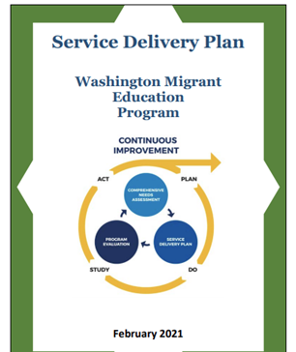
NEW: Goals in Service Delivery Plan 2021-2024
Graduation and
Out-of-School Youth Achievement
Eliminating Educational Barriers through Support Services
Service Delivery Plan PDF
Notes:
Sign in sheet:

Slide 27
Implementations Ideas to Meet Goals of Services
Graduation and Out-of-School Youth Achievement Implementation
Continues options for implementation
Eliminating Educational Barriers Through Support Services
Notes:
Sign in sheet:

Slide 29
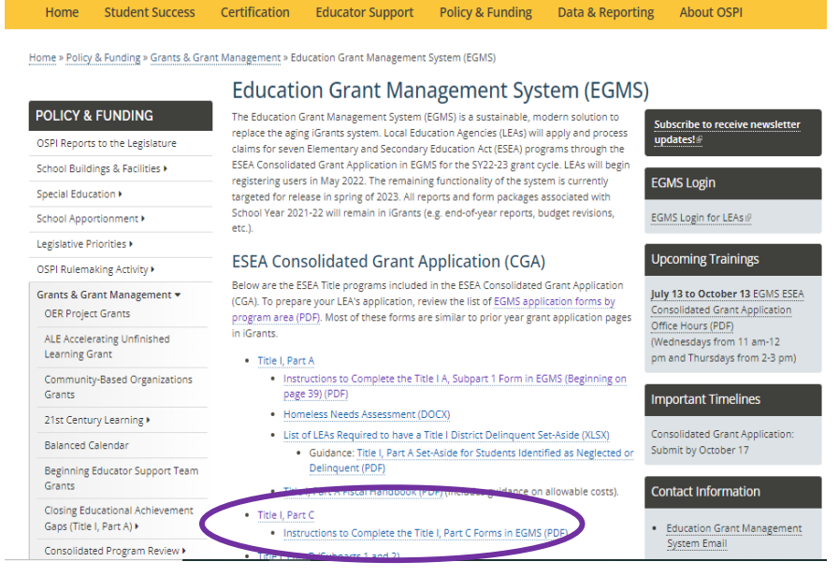
EGMS Important Information:
Education Grant Management System (EGMS)

Slide 30
New Education Grant Management System
Resources:
EGMS OSPI Training Presentation and Video Tour of EGMS

Slide 31
Parent Advisory Council (PAC):
Recommendation is 3 meetings a year:
Fall-Implement/Evaluate
Winter:Implement/Evaluate
Spring: Evaluate/Plan
51% migrant parents officers
Bylaws, update every 3 to 4 years
Agendas and minutes saved
In order to build a relationship, they may wish to have a few more meetings during the school year
PAC Guide Link
OSPI Guidance Presentation
Please connect with Claudia Dominguez-Figueroa, Migrant Family Engagement and Student Leadership Coordinator
Claudia.dominguez@esd105.org

Slide 32
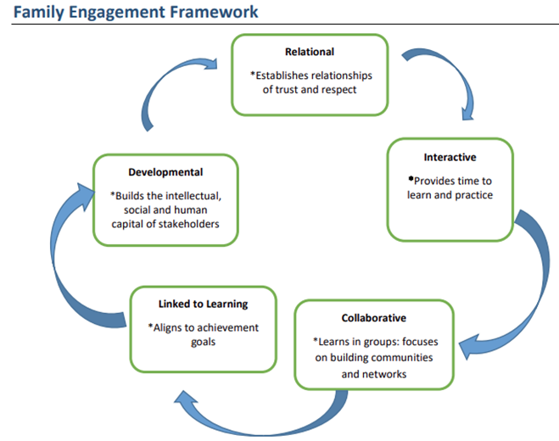
Family Engagement Framework
Parent evaluations
Required for any migrant funded ELA or Math Family Literacy Activities
Due End of Year Report
EGMS input information
Select trainings parents requested

Slide 33
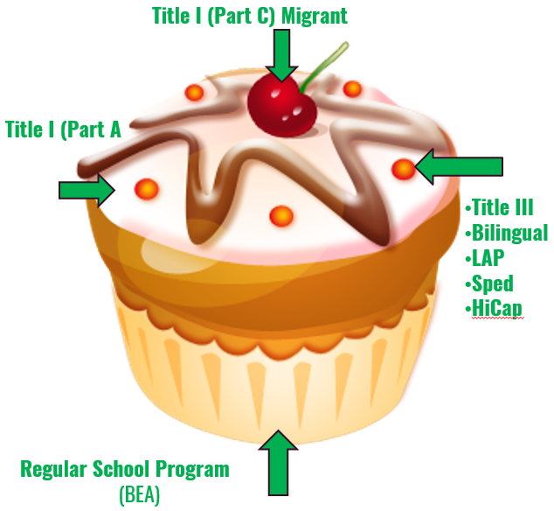
Supplement vs. Supplanting
All MEP supplemental (addition/extra) programs services are to assist in the achievement and success of migrant students' graduation or GED completion.
MEP funds are to be used as last resort after exhausting all other districts program funds.
Notes:
Explain cupcake model
Relate to tiers of intervention? If Migrant is a Tier 3 support, the sprinkles must be Tier 2, and the cupcake must be Tier I.
Link to Definition of Supplemental Services: Supplemental vs. Supplanting pg. 8

Slide 34
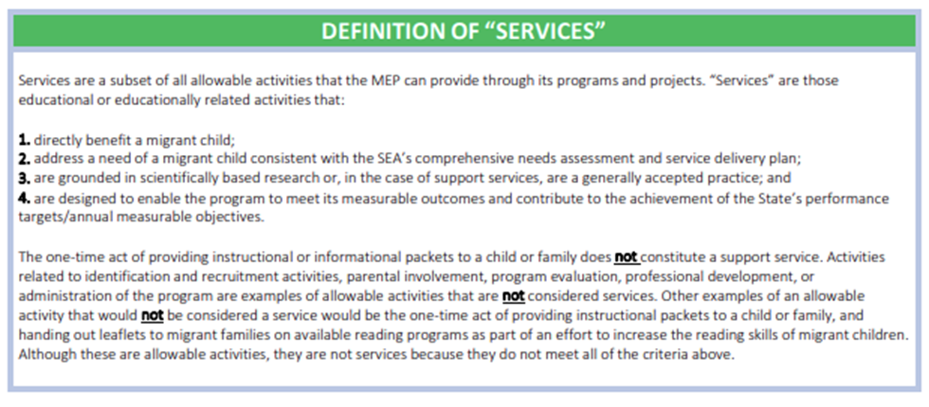
A Service to Youth:

Slide 35
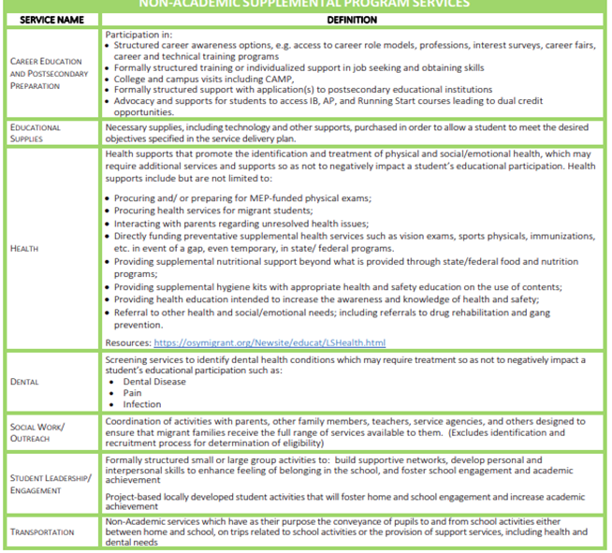
MEP Non Academic Services
Supplemental Services Definitions Doc
Notes:
Sign in sheet:

Slide 36
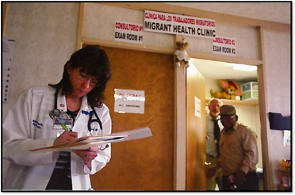
Bridging Access to Health Services
Coordinate access to Non-Academic Supplemental Health and Social Services:
Identify and Treat Unresolved Health Problems:
For the first time, MEP grant formula to include health funds as a part of the regular allocation. All accepting MEP districts eligible and additional funding dependent on enrollment count
100 or less eligible migrant students = $1,500
100-400 eligible migrant students = $2,500
400 or more eligible migrant students = $4,000
Contact Valeria Villa for support in this area: Valeria.villa@esd105.org
Notes:
Sign in sheet:

Slide 37
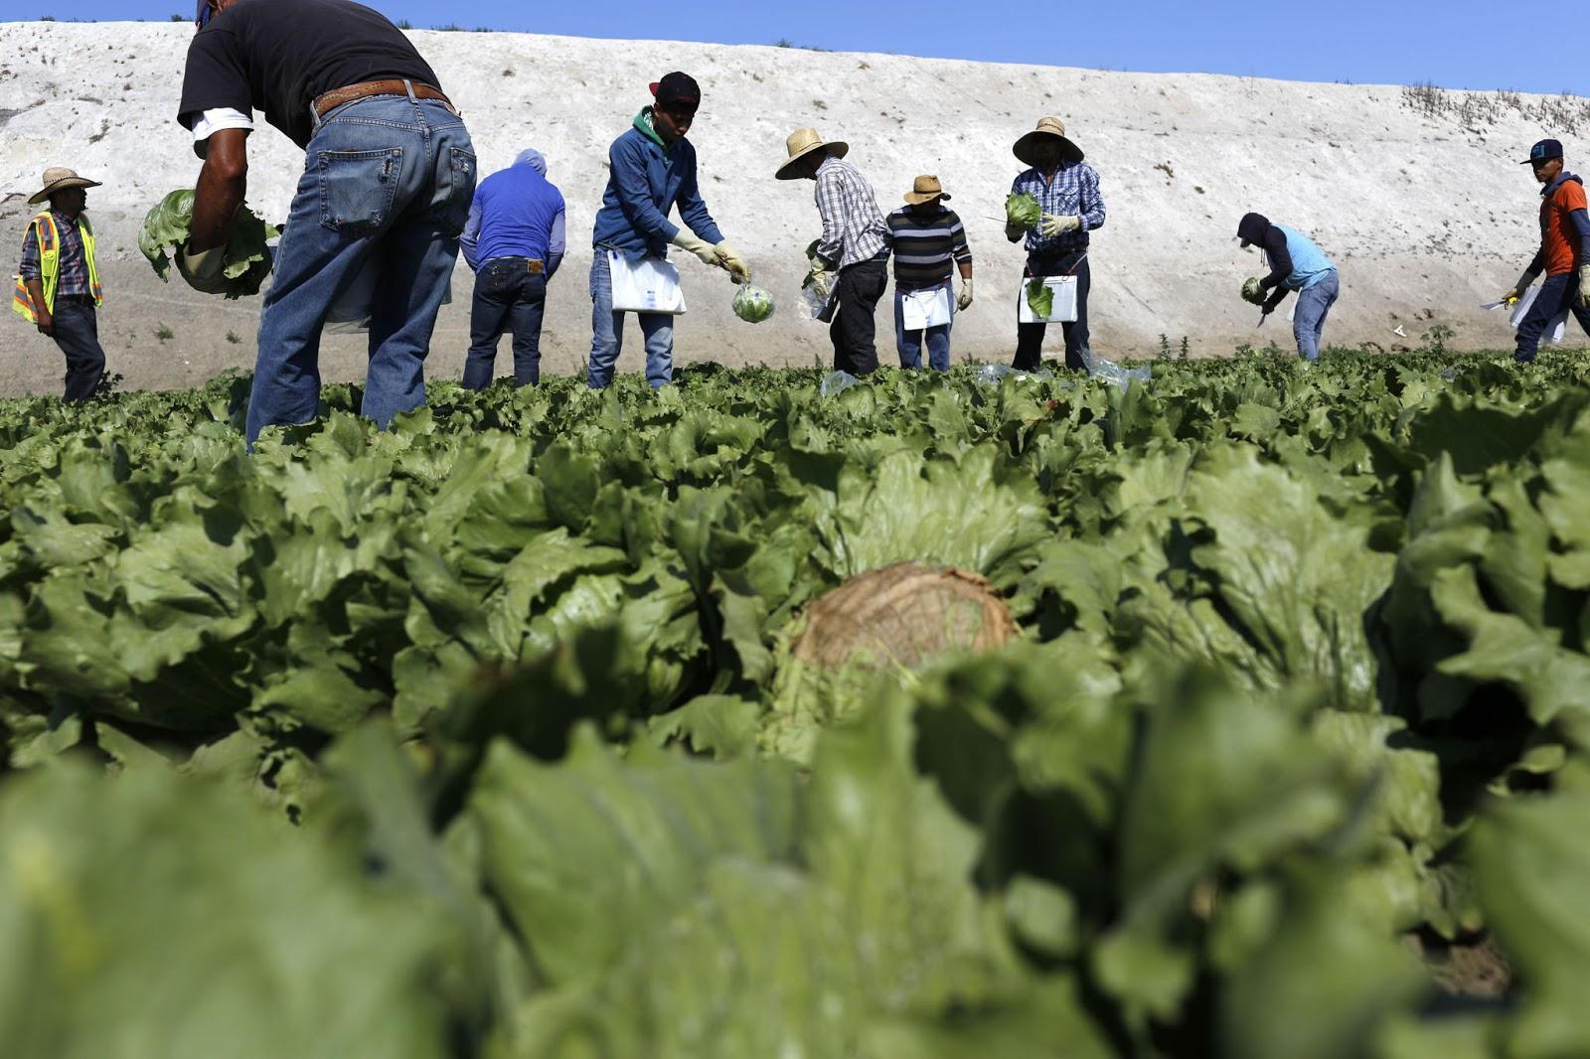
Serving Migrant Out-of-School Youth
Supporting districts’ in service of OSY
Identify Migrant students that are out of school.
Look where OSY left off Academically
Reach out to OSY and Family
Identify if OSY wants to go back to school or what educational next steps are
Develop plan WITH OSY for reintegration to education if desired
Contact Valeria Villa for support

Slide 38
Migrant Academic Services
Supporting districts’ delivery of migrant-inclusive K-12 instruction:
Technical assistance regarding program/intervention design, implementation & grant-required reporting
Regular-year AND intersession
Responsive professional development & wrap-around capacity-building supports for migrant-inclusive instruction
Facilitator of grant-required Migrant 101 training via in-person/virtual modules
Trainings: (across the content areas)
WIDA
Science of Reading
Literacy/numeracy strategies (for migrant students and parents)
MTSS and the early screeners law
Assessing multilingual learners Trainings: (Continued)
Individualized teacher support
CCSS and rigor
Language acquisition
PD for Paras
Supporting newcomers
In-class demonstrations
Scaffolding
Gamifying content
Intervention strategies
Using data to inform instruction
Enrichment VS. Remediation
Accelerating learning strategies
Please connect with:
Angelica Hernandez insert job title, Coordinator
Angelica.hernandez@esd105.org
Erica Peppers Mears, Migrant Academic Coordinator Math & Science
erica.peppers@esd105.org

Slide 39
School District Support: A Team Effort
OSPI MEP
Develop and oversee the implementation of the State Service Delivery Plan (SDP) and measurable program outcomes.
Receives, approves iGrants and allocates funding to Districts
Fidelity of Strategy Implementation
CPR Reviews
Collect end-of-year reporting
ID&R Trainings
OSPI MEP Quarterly Webinars
Oversees 3 PAC Parent Input
Summer Academies
ESD 105
Supports and Trainings:
iGrants Tech
Parent Advisory Council
Math/ELA Academic
Migrant Parent Trainings
Out-of-School Youth
Re-engagement
Migrant 101
Health/Dental
Migrant Graduation Specialist and Migrant Student Advocate
FPD tech support
MEP Orientations
Migrant Family Engagement
Migrant Student Data Recruitment Support Office
Recruiter Trainings
ID&R Trainings
Data Clerk Trainings
Dare to Dream
MSIS Trainings

Slide 40
What Support We Offer:
Federal Project Director Technical Support
Technical Assistance to Identify and Plan for Supplemental Services
Migrant 101 and 201 Trainings that offer awareness to educators on the unique needs of migratory children and families
Services to Support Districts and School in Analysis of Data
Applied Science, Math and English trainings aligning with Washington State K-12 Learning Standards and Next Generation Science Standards to support English Language Learners
Training and Technical Assistance for Migrant Graduation Specialists, Student Advocates, Recruiters, and Record Clerks
Migrant Summer School Support & Planning
Training and Technical Assistance to school migrant program staff to Re-engage Out-of-School Youth
Training and Technical Assistance to school migrant program staff to support the Health of Migratory children and families
Family Engagement Training to Districts
Compliance and Evaluation Services
Re-engagement support and services to Out-of-School Youth ages 16-21 years old
School Readiness Support for Early Learners
Career Readiness support

Slide 41
MEP: A Team Effort
Innovative Projects:
Rising Together Leadership Conference in March 2024. More information to come.
Parent Enrichment Session.

Slide 42
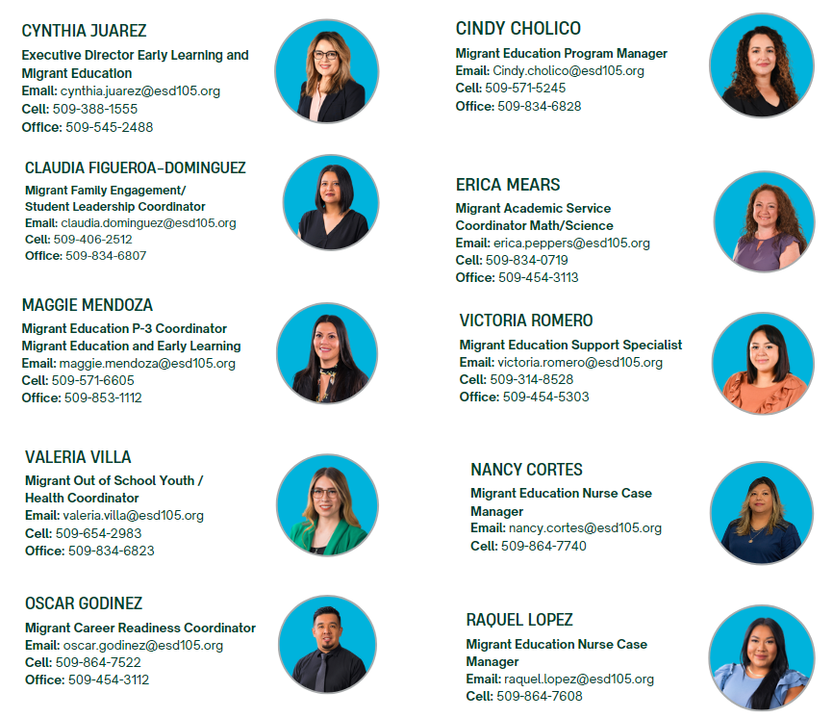
Contact Information

